Slide 1

COMPARISON BETWEEN MONGODB & SQL
PARADIGM
SQL databases, also known as relational databases, were designed to store data that has a structured schema. The schema represents the design of the database to which the data should adhere to. In a structured schema, data is saved in a row-column format known as a Table and can be retrieved using queries formatted in the Structured Query Language (SQL).
NoSQL databases started arriving on the scene. These new databases needed to support this different type of data that was unstructured and not suitable for schemas; data like key-value stores, documents, text, graphs, and wide columns. MongoDB, for example, mainly supports unstructured Documents.
MONGO DB | SQL
NoSQL supports unstructured data | SQL, supports structured data with schemas

Slide 2
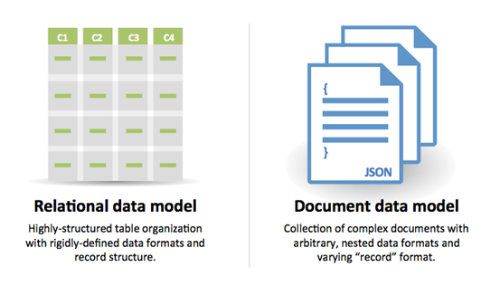
HOW THE DATA IS STORED
In SQL, the data is stored in tables, where the column denotes the attribute and row represents a particular record. These tables, in turn, reside inside the databases.
In MongoDB, data is stored in collections that are analogous to MySQL tables. A collection can consist of many documents in which data is stored in JSON format of key-value. There can be hundreds of such collections inside a MongoDB database.
The architecture of SQL databases like MySQL is governed by the principles of ACID property.
ACID stands for Atomicity, Consistency, Isolation, and Durability. These properties focus on the consistency and reliability of the transaction done in the database.
MongoDB is built on the principles of CAP Theorem which focuses on Consistency, Availability, and Partition. Unlike the ACID properties of SQL databases, CAP theorem focuses on availability of data in the case of MongoDB.

Slide 3
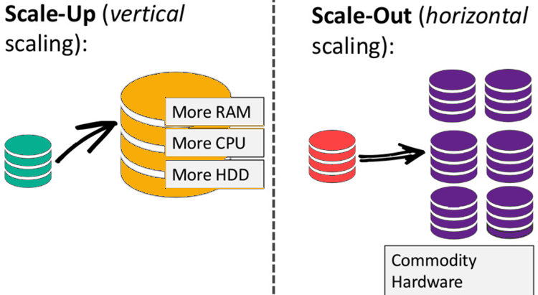
SCALABILITY
MySQL database or the SQL databases, in general, can be scaled only vertically by increasing memory size, disk space or computing power of the server. Vertical scaling can be expensive with costs growing rapidly for large databases with high query volume.
NoSQL databases like MongoDB support horizontal scaling, also known as sharding. In this case, instead of increasing the server configuration a new server is added for the purpose of scalability. This approach is usually less expensive because a cluster of low-cost commodity hardware can together meet the requirements to support high query volume in a cost-effective manner.

Slide 4
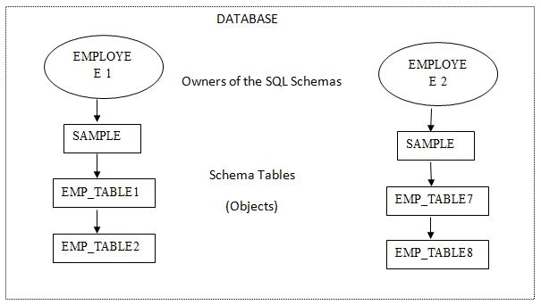
SCHEMA
MySQL databases, like any other SQL databases, have a predefined schema to which the data should comply. For example, the number of columns in a table along with its data type has to be defined while creating the table. Any data that is saved in the table should match the table structure, otherwise, it will give an error.
On the other hand, in MongoDB, there is no need to predefine any schema. A collection can store different types of documents without any problem. There is nothing to worry about if a new type of document arrives, it can easily be saved.
The dynamic nature of MongoDB schema is useful because most of the data that is being generated by internet applications and IoT devices are non-structured which cannot be saved in a traditional SQL database.
Additionally, many companies will store data before they know how it will be used later. This is common with mobile apps storing log data and user activity. As the company gets their apps on the market, they collect data without an end goal. Later, they may discover that this data gives them valuable information of what features need to be added. With unstructured databases, it is easier to do this sort of unplanned data collection because there is no need to define a schema ahead of time.

Slide 5
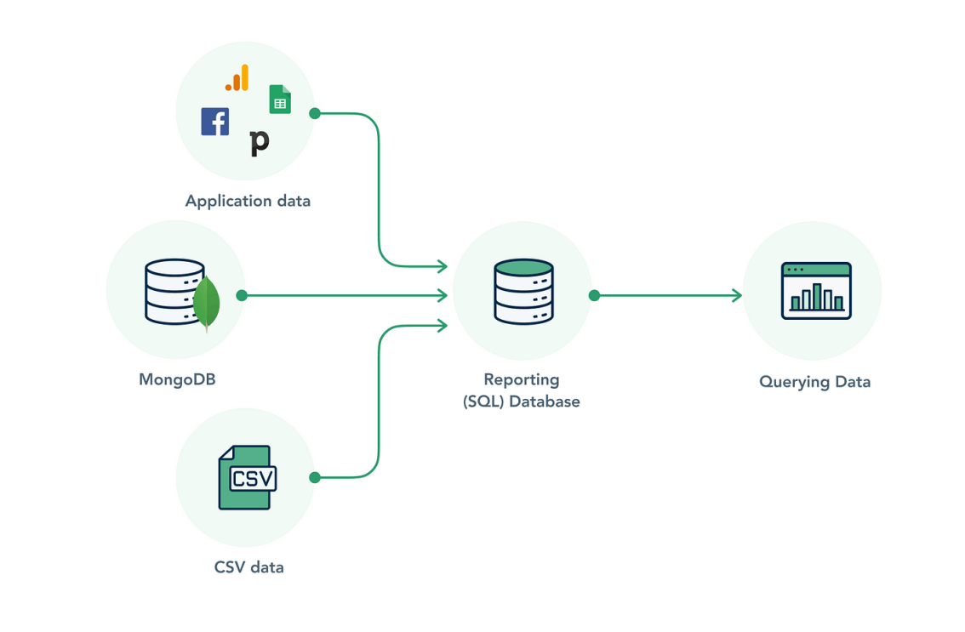
QUERY AND ANALYTICS
MySQL database can be queried with the help of Structured Query Language or SQL. In fact, MySQL follows ANSI SQL standards which is a common SQL standard adopted by almost all relational databases like Oracle, PostgreSQL, Sybase, etc.
SQL queries are developer-friendly and well established. SQL can be used to perform advanced analytics functions like filters, joins, merge, and aggregation on the data as well. This makes SQL a powerful option for performing advanced analytics.
MongoDB does not support the traditional SQL queries the way MySQL does. MongoDB does, however, support document querying, but the feature is underdeveloped and limited–especially compared to SQL. One example of this is that MongoDB queries do not support joins, which is a crucial operation to derive information from multiple sources of data.
So MongoDB is useful for storing unstructured data but it does not offer a mature query language to perform advanced analytics.

